Slide 1
CyberCane
Notes:
More specific tagline: “revolutionary cane for the blind”, more emotional impact

Slide 2

Mission statement:
To assist those who are visually impaired through an innovative cane
Notes:
Tech notes, BT, GPS

Slide 3


Notes:
More organization for problems list, emotional investment

Slide 4
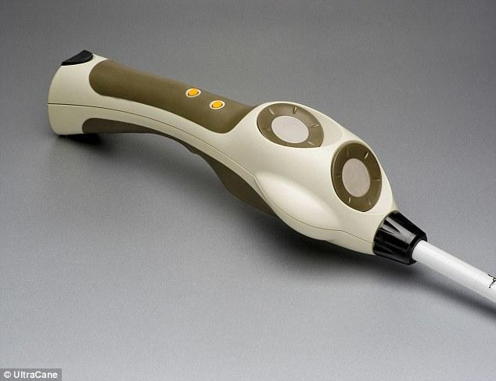
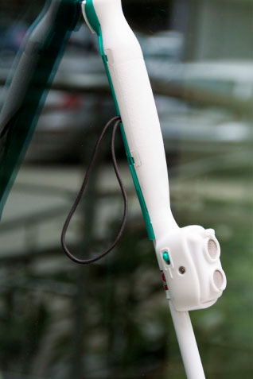
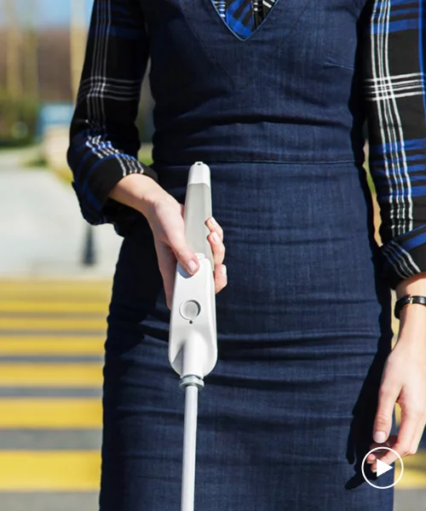
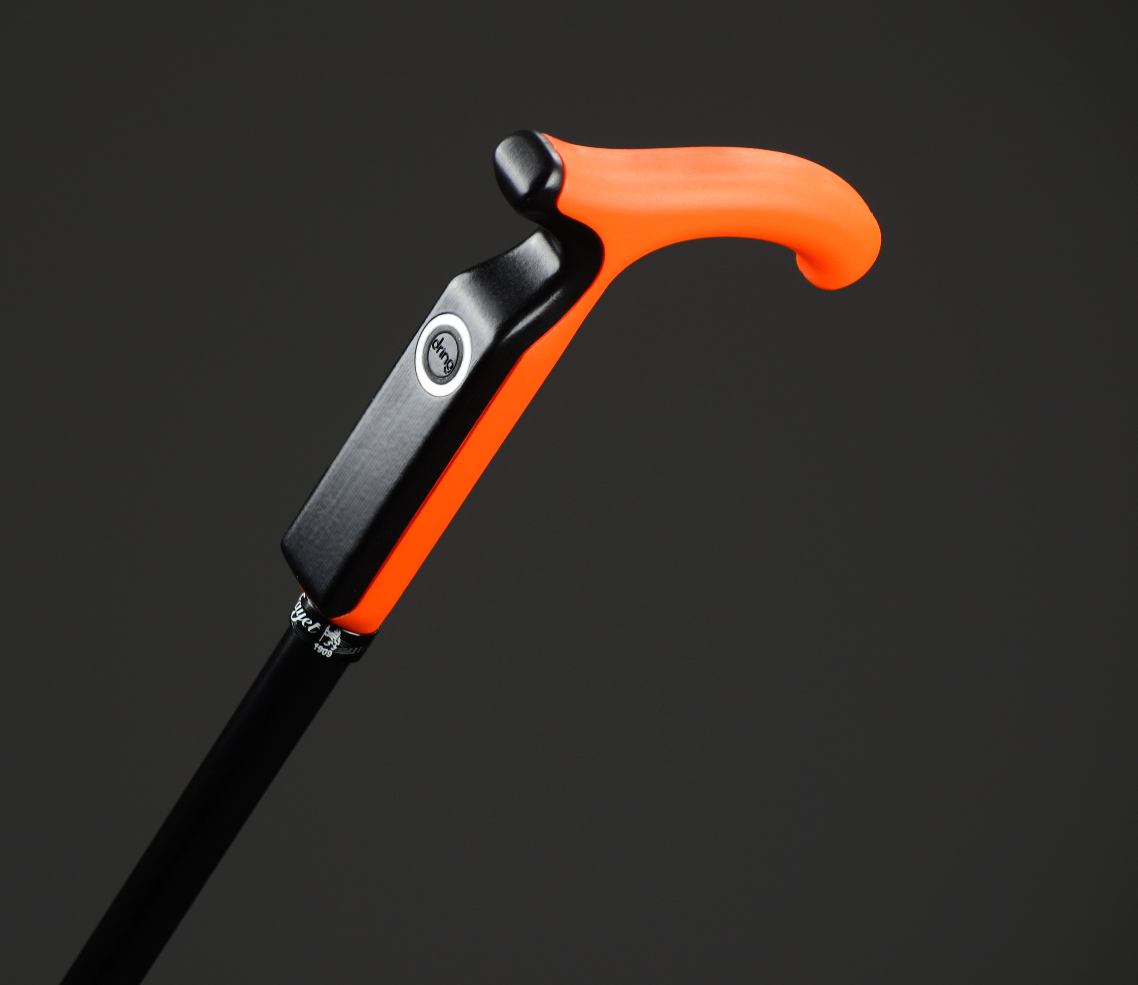
Competition
Notes:
Cost, haptic feedback, design,

Slide 5
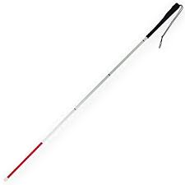
Current White Cane
Issues:
Durability
Portability
Sensitivity
Height
Aesthetics
Benefits:
Visibility
Notes:
Mention Carroll Centre and MVPs
Delete slide-- copy notes
Wrist fatigue

Slide 6
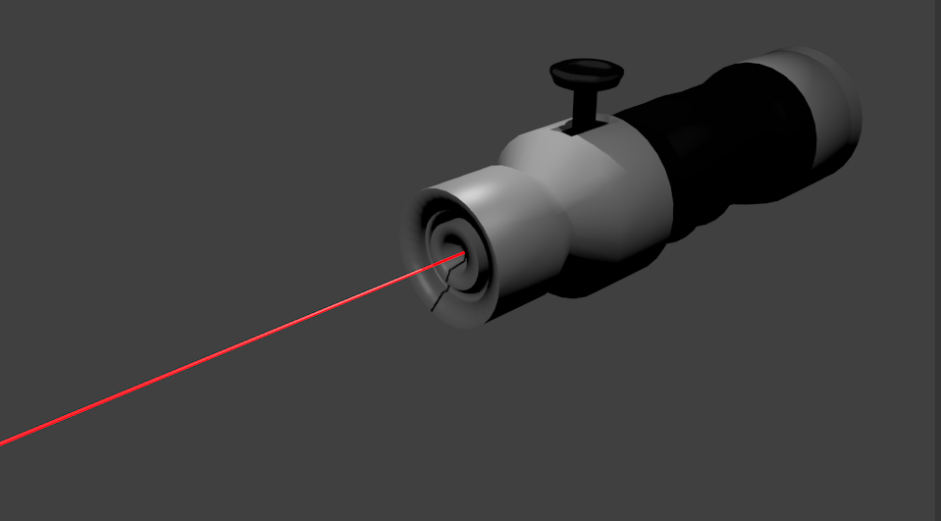
CyberCane Features
Laser cane with comfortable handle
Obstacle detection
Eliminates issues from low-tech materials (i.e splintering, cracking)
Light-weight
Notes:
Move bullets to speaker notes
Haptic feedback
Crosswalk interactivity-- France

Slide 7
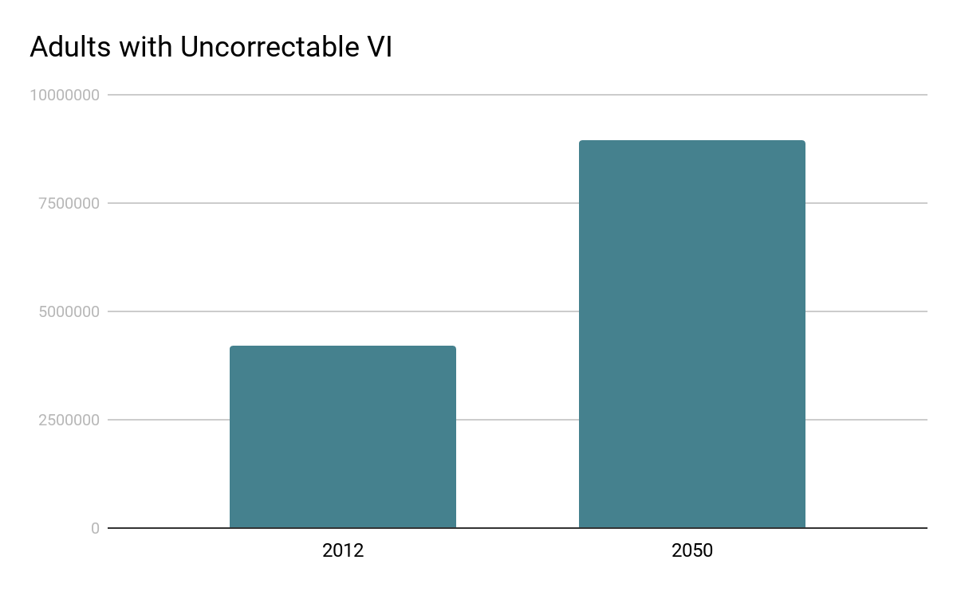
Setting the Scene: Visual Impairment
Longevity
Increasing health issues
2-8% of VI use canes
Notes:
Citations
Here are the issues (Carroll Centre), the competitors don’t understand the market (things they are doing wrong), why CyberCane is better (our advantages compared to current market), tech, prices and distribution
Move earlier- world sucks for a large number of people
Justification more important than the actual numbers

Slide 8
How it works: Capturing our segments
Step 2
Step 3
Step 1
Based on the tests, cane is recommended to optometrists and other health professionals for distribution and credible recommendations to customers
CyberCane is also sold online, with the advantage of being able to pay in installments (interest included)
A limited number of canes are given out to schools and learning centers for those who are VI to test
Notes:
Qualify statements (Do optometrists even recommend white canes?)
Will learning centres partner with us?
Specific distribution opportunities
step 1: beta testing
Step 2: establish credibility with health professionals

Slide 9

The technology:
Laser, bluetooth, GPS
Notes:
In our own research, our CyberCane should cost x amount of dollars based on technology (research price points)
Why now?

Slide 10
Engineers
Superior product functionality
Competitive differentiation
IT support
Customer service
Researchers
Competitive technology
There are three main components that are critical to our team and value proposition.
Notes:
Salaries/price points/wage expenses for Engineers, researchers, IT support (PhDs salaries)
Why are these things necessary and at what level? (embedded software engineers, location of business)
Solid numbers (conversion, $)
Group w/ competitor slide

